Slide 1
A Simple, Automated and Easy to Deploy SDN Solution
Roni Mukherjee
MS, Telecommunications 2019-21, CU Boulder

Slide 2
Why SDN?
Reduced CapEx: Simple device – move control away from devices
Reduced OpEx: Simplified network monitoring – automation
Build your solution
Faster troubleshooting

Slide 3
Hybrid Network
Combination of SDN and Traditional Routing and Switching Networks
No need to change traditional network
SDN network is spun up to join the network
Based on the implementation, SDN Controller can be anywhere in the network
Only, IP connectivity is required to establish a TCP/TLS connection between the SDN switch (s) and the controller (s)

Slide 4
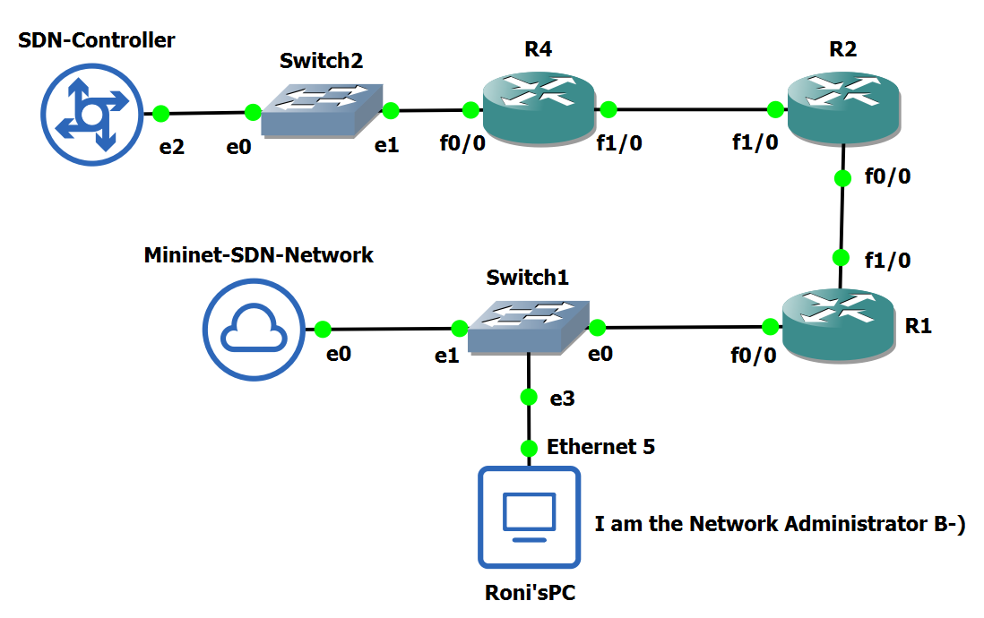
Hybrid Network – Proof of Concept

Slide 5
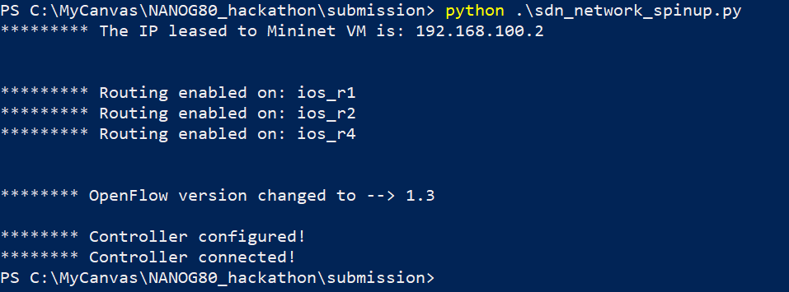
Automated SDN Deployment
Mininet boots up, gets DHCP address, routing enabled, controller configured – Automated

Slide 6
Advantages of the proposed solution
Easy to deploy – Automated script (boot up/routing/monitoring)
SDN – Centralized control, global view, reduced CapEx and OpEx
API – Use of APIs make it faster and human readable
No need to change existing network
Reuse SDN multipurpose simple devices
GUI: Greatly increased troubleshooting efficiency

Slide 7
SDN GUI – Reusable/Extendable Global View
Purpose-built for the proposed network
Web Application Console logs
Web GUI
Real-time graphical plots of the network (auto-refresh every 5 seconds)
Greatly reduced troubleshooting steps – match on 40 fields and create own flow

Slide 8
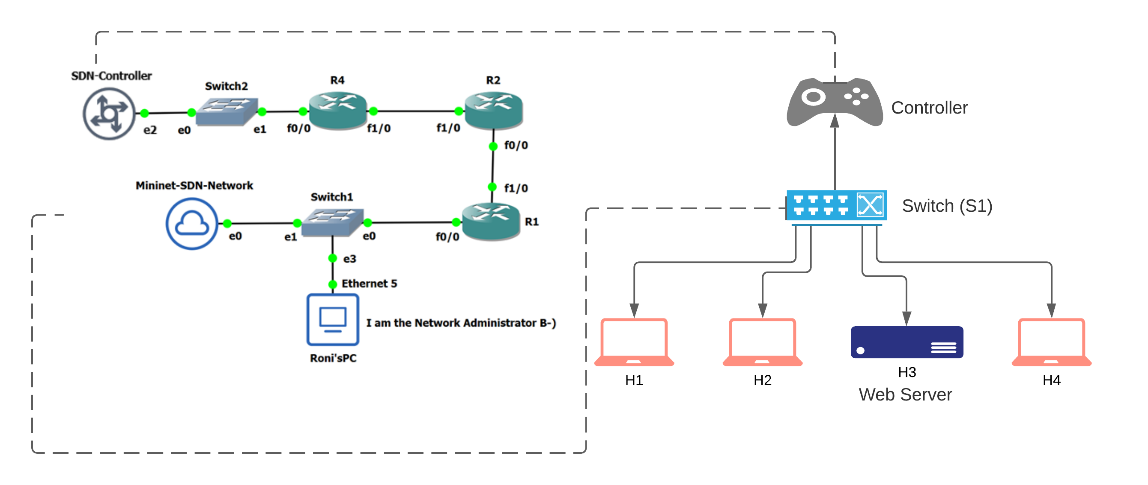
SDN Topology

Slide 9
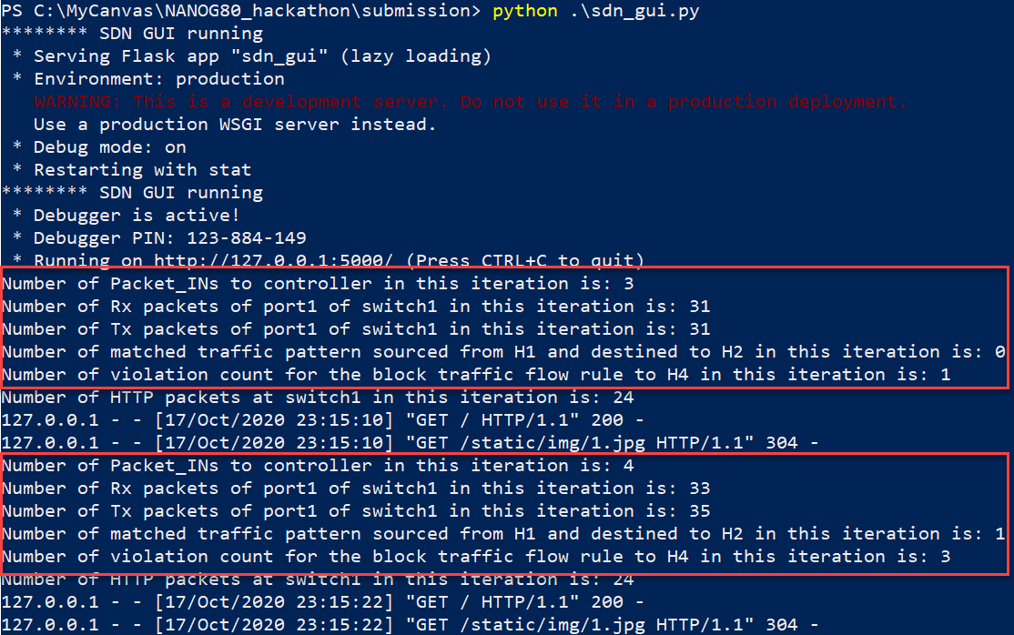
SDN GUI – Console Logs

Slide 10
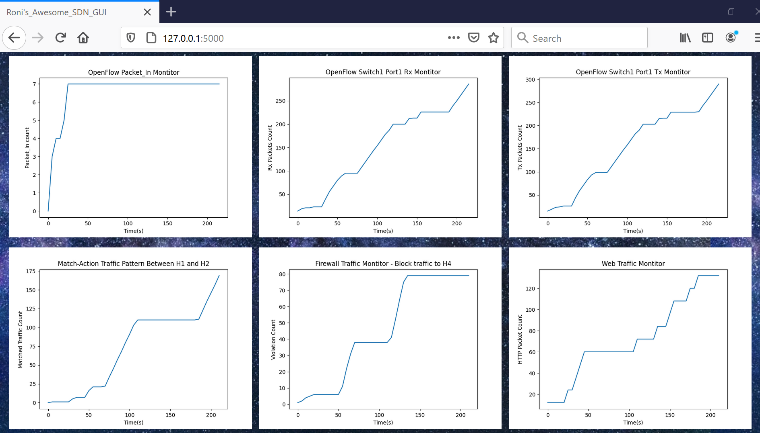
SDN GUI – Web GUI

Slide 11
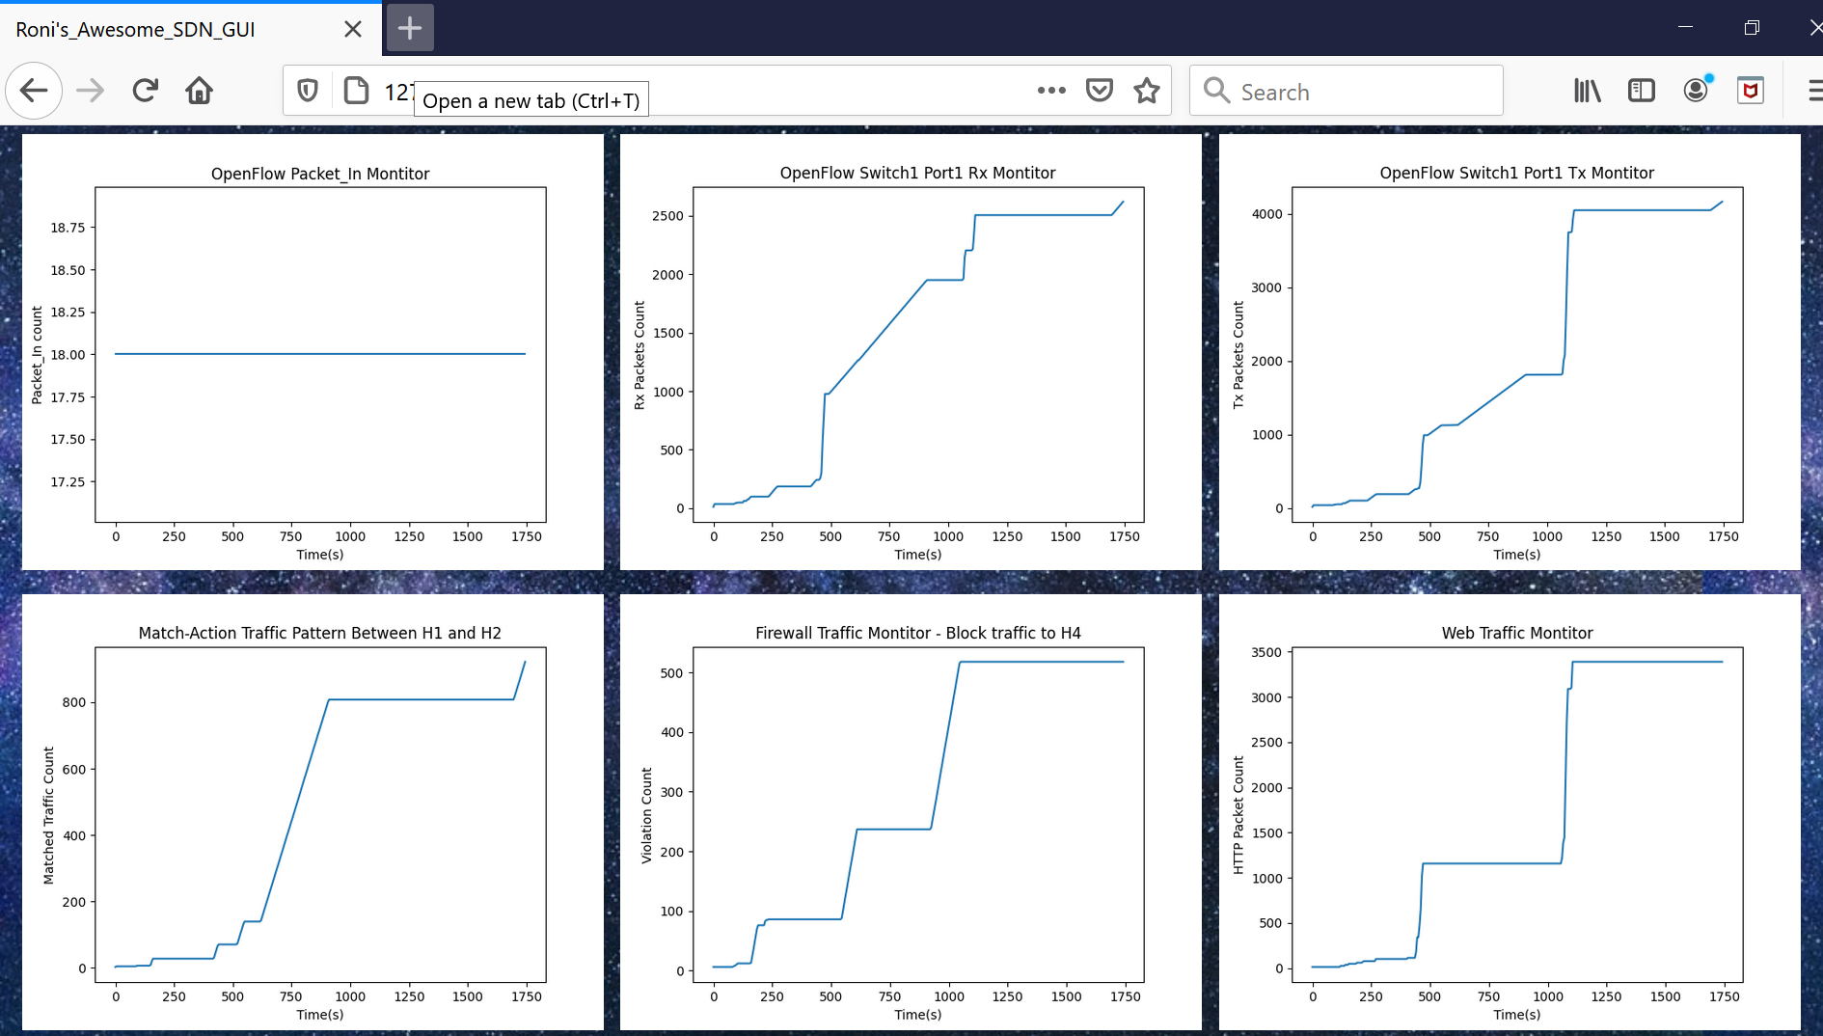
SDN GUI – Web GUI

Slide 12
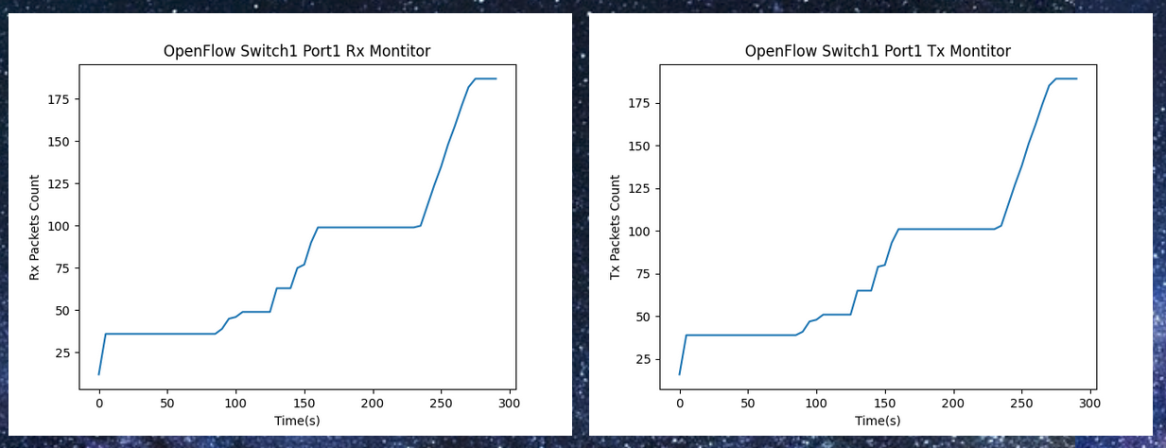
SDN Web GUI – Switch Tx/Rx Monitor
Tx/Rx traffic has a similar pattern.
If there is a significant difference between Tx/Rx traffic, captured on graph and an email is sent to the administrator for immediate action.
Graph is plotted against real-time data and refreshed every 5 seconds.

Slide 13
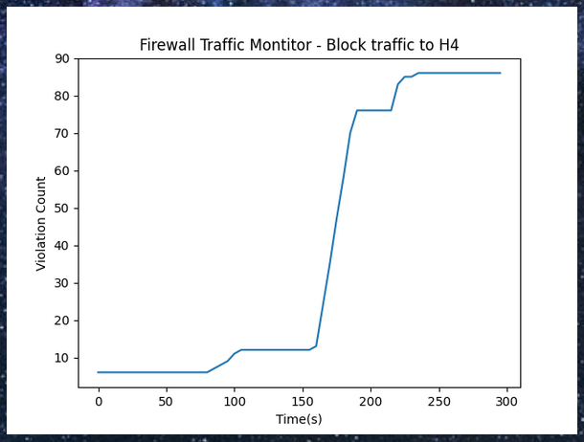
SDN Web GUI – Firewall Monitor
Custom firewall rule is created.
If there is a significant increase in violation count, captured on graph and email is sent to administrator for immediate action.
Graph is plotted against real-time data and refreshed every 5 seconds.

Slide 14
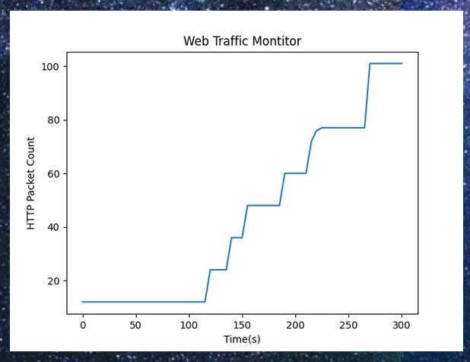
SDN Web GUI – Web Traffic Monitor
One of the host is web server and serving HTTP requests.
This is a critical service.
If there is a significant change in traffic pattern, captured on graph and an email is sent to the administrator for immediate action.
Graph is plotted against real-time data and refreshed every 5 seconds.

Slide 15
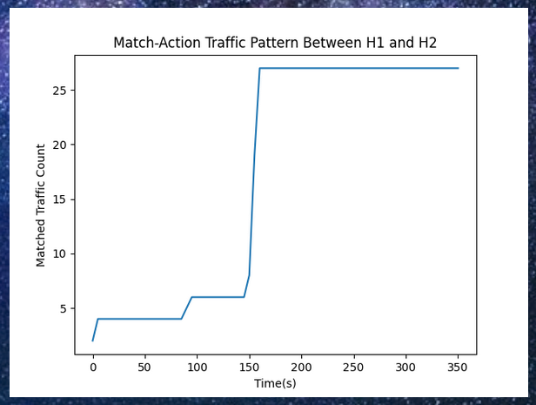
SDN Web GUI – Pattern Traffic Monitor
Custom match is created for traffic pattern, e.g. traffic sourced from MAC address of H1 and destined to MAC address of H2.
This is considered as critical service.
If there is a significant change in traffic pattern, captured on graph and an email is sent to the administrator for immediate action.
Graph is plotted against real-time data and refreshed every 5 seconds.

Slide 16
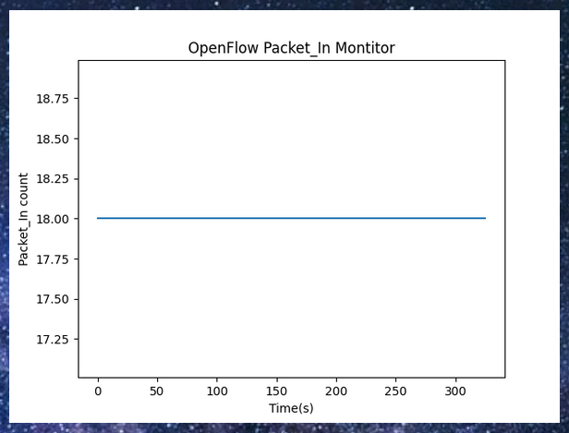
SDN Web GUI – OpenFlow Packet_In Monitor
Traffic from switch to controller.
This is the traffic that matches table-miss.
Graph is plotted against real-time data and refreshed every 5 seconds.

Slide 17
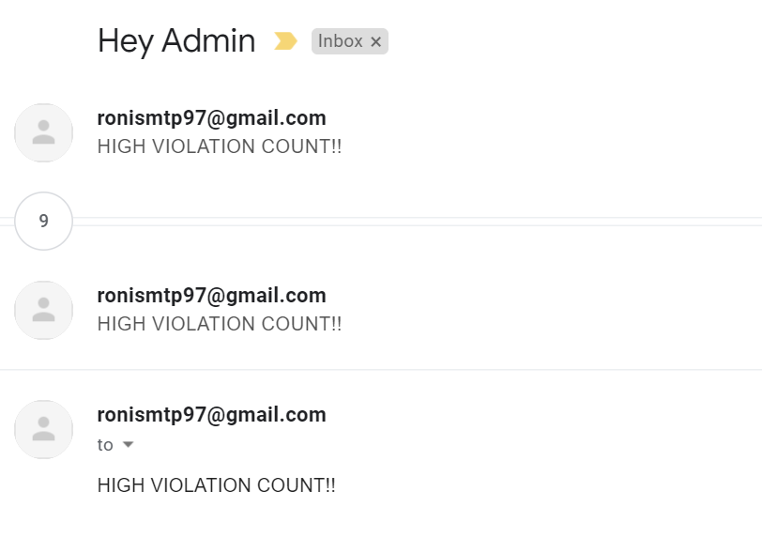
SDN Web GUI – Violation email

Slide 18
Tools used
GNS3
Cisco IOS routers
Mininet
Ryu SDN controller
Ubuntu VMs
VirtualBox
Flask
HTML/CSS
Netmiko
NETCONF
Python
Wireshark

Slide 19
Conclusion
Custom flow rules using any match criteria (from 40 different fields)
Graphical representation – significantly increased troubleshooting efficiency
Hybrid Network
Reduced CapEx: Simple device, reusability
Reduced OpEx: Significantly improved network monitoring and troubleshooting through automation
Automated deployment of the Hybrid-SDN solution

Slide 20
GitHub
https://github.com/rm-viable/NANOG80-hackathon

Slide 21
Questions

Slide 22
Booting up the SDN Network

Slide 23
RYU controller is running on a separate VM

Slide 24
Topology on GNS3

Slide 25
OSPF not running on any routers

Slide 26
Ping to controller does not work from Mininet

Slide 27
Executing the SDN Network Spin Up code

Slide 28
Ping to controller works now

Slide 29
OpenFlow 1.3 messages captured on Wireshark

Slide 30
Questions

Slide 31
SDN GUI Code Executed

Slide 32
H1 pings H2

Slide 33
Match Traffic Pattern (H1-H2)
Tx, Rx increases at S1 Port1 (H1 connected to port1)

Slide 34
Firewall Violation
Block traffic to H4: H1 pings H4
If violation count is more than 20; send email to admin

Slide 35
Web Traffic (Match TCP port 80)

